Slide 1

Perth Machine Learning Group
Current state of AI and where we are going with PMLG
2023

Slide 2

To stand on the shoulders of giants

Slide 3
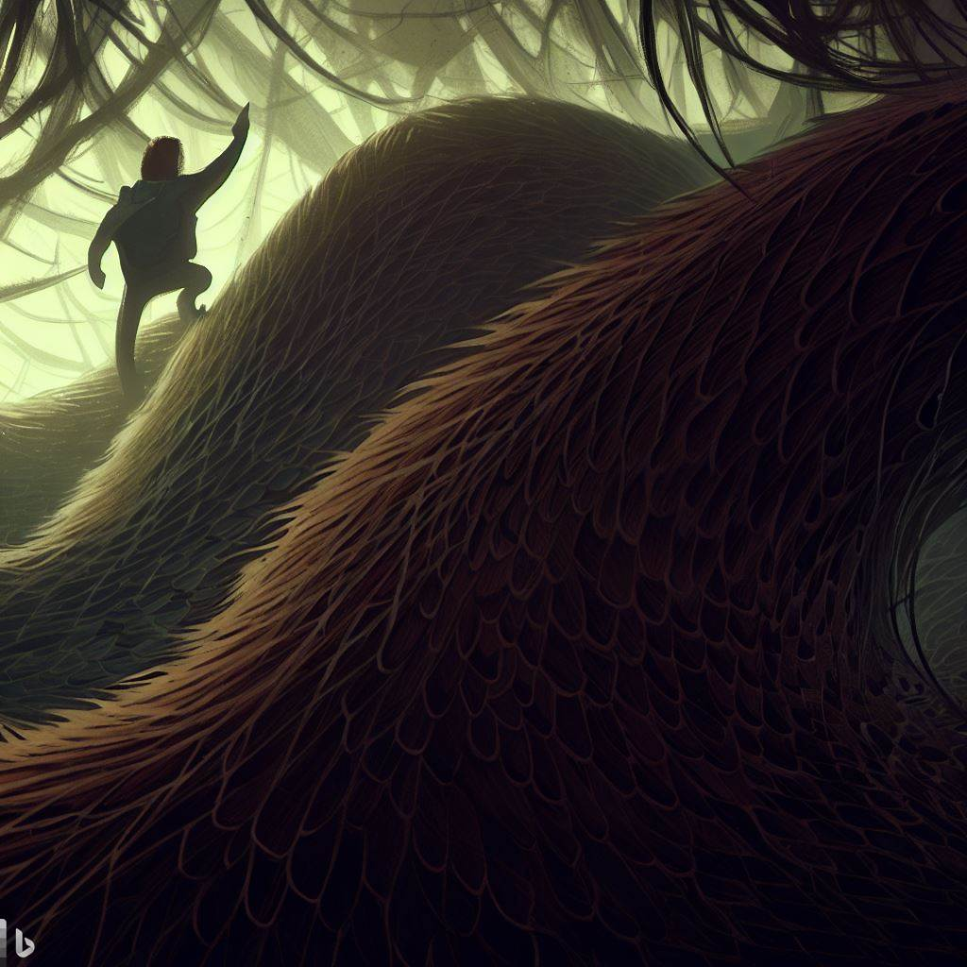
You must first climb their backs, traversing thick forests of hairy IP and slippery scales of non reproduceable results

Slide 4

where are we currently

Slide 5
Language as a graph
the
cat
sat
on
the
mat

Slide 6
the
cat
sat
on
the
mat
,
?
?
it
was
cold

Slide 7
Language models trained to guess next node in graph
?
the
cat
sat
the
mat

Slide 8
Questions are partially observed graphs

Slide 9
the questions is part of the context and used to guess the next node

Slide 10
….and extrapolates
meaning of life?
42
Cats

Slide 11
Transformers are working on graphs and nodes
Function is very similar to parts of the brain
The models of these parts of the brain blend spatial/structural and sensory inputs
The division of spatial and structural input may also seen in transformers
This knowledge could guide us on how we can better train transformers
Transformers layers behave as a special case of Modern Hopfield networks
Modern Hopfield networks are capable of continuous learning and don’t need backprop
You can train regular Transformers without backprop too
Modern Hopfield networks storage capability scales exponentially with nodes
Hopfield networks are energy based models, potentially keys in well with JEPA style architectures

Slide 12
Structural representation
Sensory representation
Routing

Slide 13
My guess this is what is being worked on now for the next generation of models.
Capabilities, continual learning, not frozen graph
May see large improvements in small models, as we address learning.
Potential for planning capability
Orientation to more executive coordinating role in cognitive architectures

Slide 14
Source: https://doi.org/10.1016/j.cell.2020.10.024

Slide 15
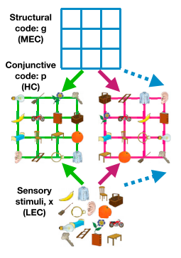
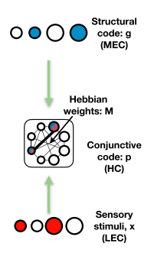
Abstract location Medial EC
Structural knowledge
Sensory input Lateral EC
Sensory representation

Slide 16
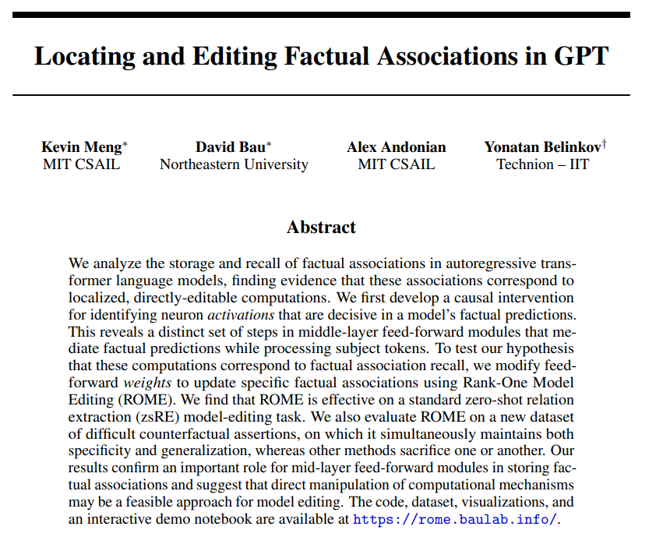
Source: https://arxiv.org/abs/2202.05262

Slide 17
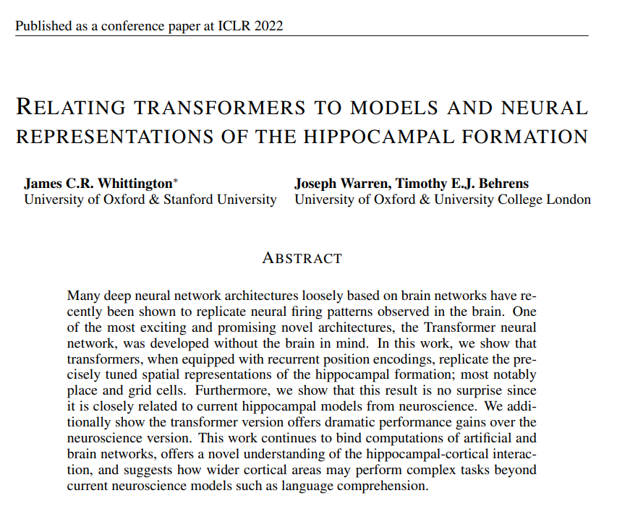
Source: https://arxiv.org/abs/2112.04035

Slide 18
The Tolman-Eichenbaum Machine (TEM; Figure 2, further details in Appendix) is a neuroscience
model that captures many known neural phenomena in hippocampus (HPC) and entorhinal cortex
(medial/lateral; MEC/LEC). TEM is a sequence learner trained on tasks exactly like the one described in the previous section. TEM consists of two parts;
1) A module that aims to understand where it is in space, using a representation g to represent
location. To update its location, TEM uses path-integration - the accumulation of self movement
vectors a - enacted in a recurrent neural network:
gt+1 = σ(gtWa) (3)
Where Wa is a learnable action dependent weight matrix and σ(· · ·) is a non-linear activation
function. It is in this path-integrating representationg that TEM learns grid and other entorhinal
cells for self-localisation (Figure 2b).
2) To make sensory predictions, location representations g alone are not enough; they must each
link to a sensory observation x, corresponding to the stimulus at that position. Note that these links
are specific to an environment, since each environment consists of a different arrangement of stimuli
in space (i.e. different stimulus-position pairings).

Slide 20
https://www.youtube.com/watch?v=5LXiQUsnHrI
Source: https://arxiv.org/abs/2302.07253

Slide 21
Slide 1: What are Hopfield Networks? A Hopfield network is a type of recurrent artificial neural network that serves as a content-addressable memory system with binary threshold nodes or with continuous variables ¹. It was popularized by John Hopfield in 1982 ¹.
Slide 2: How are Hopfield Networks Updated? Updates in the Hopfield network can be performed in two different ways ¹:
Asynchronous: Only one unit is updated at a time. This unit can be picked at random, or a pre-defined order can be imposed from the very beginning.
Synchronous: All units are updated at the same time.
I hope this helps! Let me know if you have any further questions.
In Hebbian learning, the initial weights are set randomly. This is because the Hebbian learning algorithm is an unsupervised learning algorithm and does not require training data to be set beforehand. The initial weights are set to small random values in order to avoid symmetry breaking 1.
One way to determine the connection weights is through a process called Hebbian learning. This involves looking at the input pattern and setting the connection weights so that the neurons fire in a similar pattern to the input. This is done by first setting all of the weights to random values and then exposing the network to the input pattern 1.
Slide 1: What are Modern Hopfield Networks? Modern Hopfield networks (also known as Dense Associative Memories) are generalizations of the classical Hopfield networks that break the linear scaling relationship between the number of input features and the number of stored memories 1. This is achieved by introducing stronger non-linearities (either in the energy function or neurons’ activation functions) leading to super-linear 1 (even an exponential 1) memory storage capacity as a function of the number of feature neurons.
Slide 2: How do Modern Hopfield Networks Work? The key theoretical idea behind Modern Hopfield networks is to use an energy function and an update rule that is more sharply peaked around the stored memories in the space of neuron’s configurations compared to the classical Hopfield network 1.

Slide 22
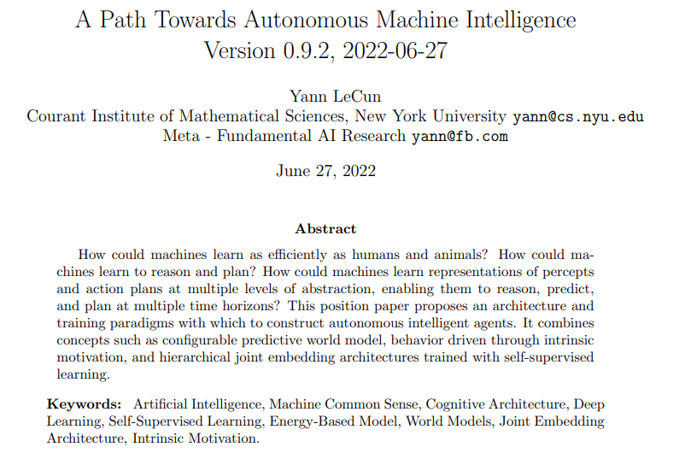
Source: https://openreview.net/pdf?id=BZ5a1r-kVsf

Slide 24
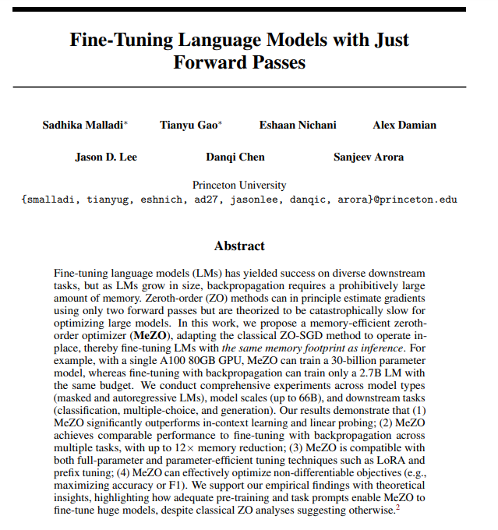
Source: https://arxiv.org/abs/2305.17333

Slide 25
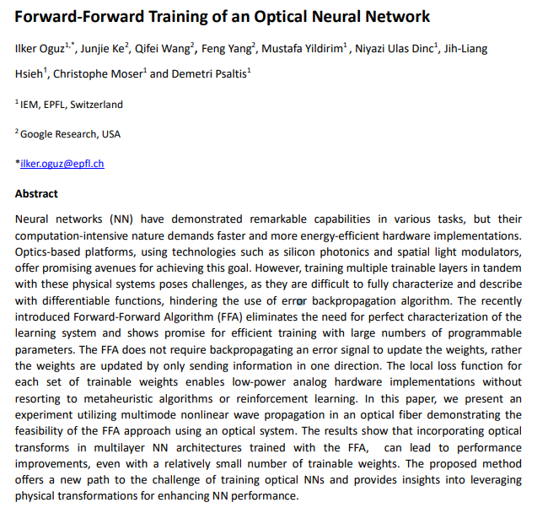
Source: https://arxiv.org/abs/2305.19170

Slide 27
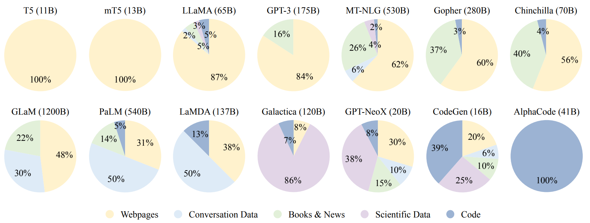
Ratios of various data sources in the pre-training data for existing LLMs
Source: https://arxiv.org/pdf/2303.18223.pdf

Slide 28
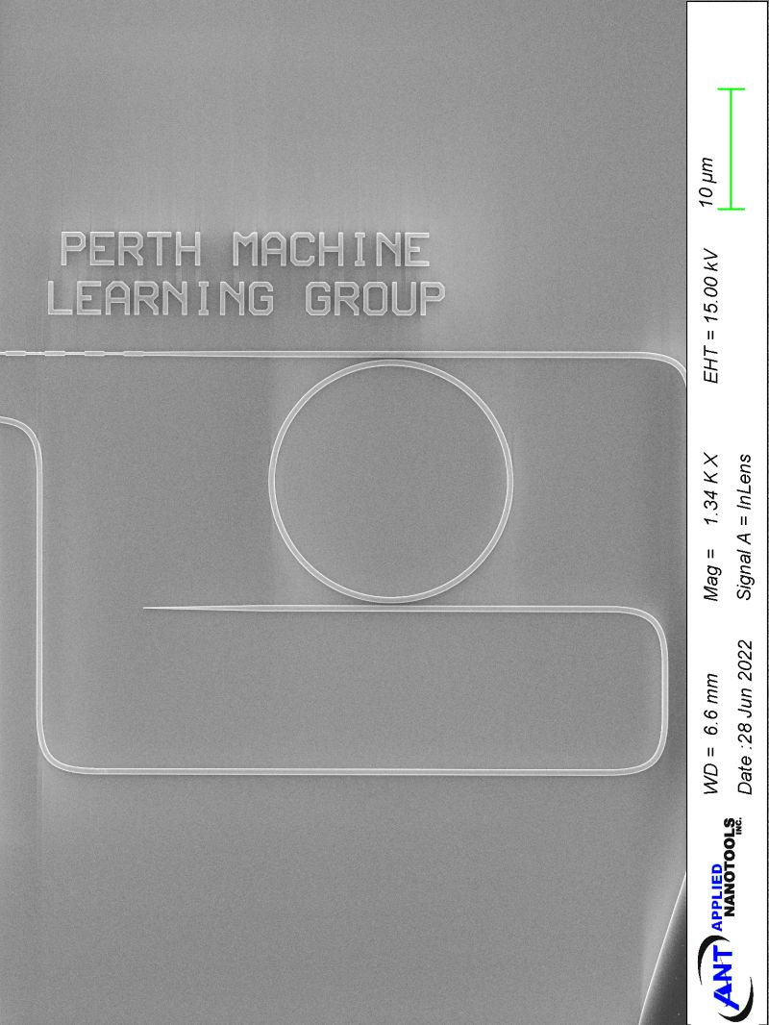

PMLG
Community
Research and Development
Research Collaborations
(3k members in 5 years)
SEM Silicon photonic neuromorphic circuit

